Slide 1
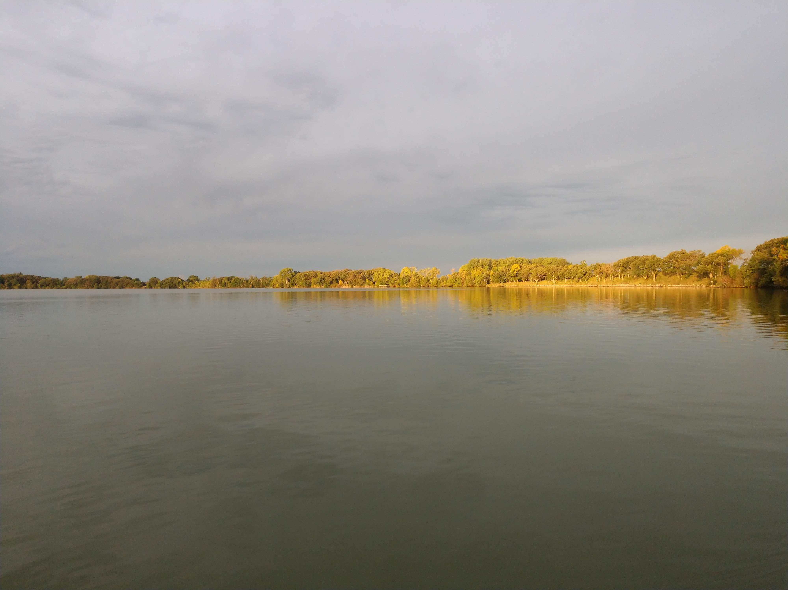
Carp and Buffalo Project Meeting
Fall 2019
Marty Simonson
Iowa State University
September 27, 2019

Slide 2
Outline
Summarize 2019 Harvest
Fieldwork Summary
  Buffalo pond experiment
Updated 2019 population and biomass estimates
Length/Age frequencies
Housekeeping

Slide 3
Harvest Summary
Highest/Lowest biomass removals
Highest/Lowest # hauls
Commercial Assistance:
  ~ 450 buffalo tagged in North Twin
  ~ 50 Carp tagged in Five Island
Insert photo of 5 island net after storm

Slide 4
Harvest Summary
Lake | Cumulative 2019 Harvest | # Hauls | Quota(s) | Difference
Blue | X | X | X | X
Center
Five Island |  |  | X | X
North Twin
Silver |  |  | X | X
South Twin | X | X | X | X
Storm |  |  | X | X

Slide 5
Remainder of 2019 Harvest
Center: couple pulls later in year
Silver: Start seine October 12
  First haul-out Monday October 14
Five Island: Later in year
North Twin: Later in year
Storm: No information available

Slide 6
2019 Fieldwork Summary
# Lakes sampled
# carp tagged, # buffalo tagged
Equipment breakdowns

Slide 7
Remainder of 2019 field season
E-fishing
  Standard runs October and November if possible
Fall standardized fyke netting
  ISU: Center, Silver, Five Island
  IA DNR: Blue, Storm, N & S Twin
Sampling not required after harvest
  Violates assumption of closure

Slide 8
Bigmouth Buffalo Pond Experiment
Tyler Butts, ISU Limnology Lab

Slide 9
Carp and Buffalo Population Estimates
Text Here:

Slide 10
Changes in Abundance
Text Here:

Slide 11
Carp and Buffalo Biomass Estimates
Text Here:

Slide 12
Changes in Biomass
Text Here:

Slide 13
Length Frequencies:
Text Here:

Slide 14
Age Frequencies:
Text Here:

Slide 15
Housekeeping
2020 Harvest Contracts:
  Same lakes?
  Quotas?
KHV and CEV protocol
Equipment, labor (tag return / harvest monitoring)
Next Meeting?

Slide 16
Slide Template
Text Here:

Slide 17
Slide Template
Text Here:

